Slide 1

Warehouse Management System
By: Trupal Patel
COMP520 – Advanced Database Systems
Spring 2025

Slide 2
Project Overview
Manage inventory, purchase orders, and storage in a warehouse
Built with Next.js frontend and MongoDB backend
Features CRUD for items, pallets, parties, and purchase orders
Estimate the number of pallets needed per order

Slide 3
Problem to Solve
Manual inventory tracking is error-prone and inefficient
No centralized system for managing warehouse items and purchase orders
Lack of real-time visibility into pallet and storage optimization
Need for a smart, scalable, and user-friendly system

Slide 4
Data Source
Simulated realistic warehouse data using faker.js
Generated mock data for:
Items – SKU, name, dimensions, category, stock
Purchase Orders – linked to vendors or suppliers
Storage Locations – structured as warehouse > unit > row > column
Enables testing of warehouse operations with varied, lifelike scenarios

Slide 5
Business Rules
Each item must have a unique SKU
Purchase Orders must be linked to a supplier or vendor
Items cannot exceed pallet weight/space limits
Each storage location must be uniquely identified by unit, row, and column
A single item can only occupy one storage location

Slide 6
Technologies Used
Next.js 15 (App Router)
MongoDB Atlas with Mongoose ODM
Material UI + Tailwind CSS
ApexCharts for interactive dashboards
RESTful API using Next.js API routes

Slide 7
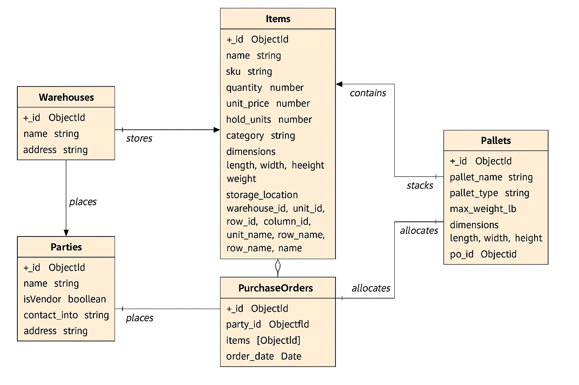
Database Design
NoSQL document schema using Mongoose
Core collections: Items, Pallets, PurchaseOrders, Parties, Warehouses

Slide 8
DEMO

